Slide 1

Cloud Solution Architect
Module 2
Lecture 5
Introduction to bash, User management and system administration

Slide 2
Recap
Module 2 - Lecture 4
Package Manager
Public Repositories
Software installation using package manager

Slide 3
Learning Objectives
Module 2 - Lecture 5
Bourne-Again Shell (bash)
Linux Kernel
User Management
System Administration

Slide 4
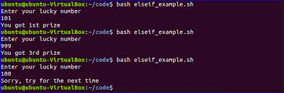
What is shell (sh)
Command language interpreter that executes commands read from a command line string, the standard input, or a specified file.

Slide 5
What is Bourne Shell (bsh)
Default interpreter for Version 7 Unix
Unix like systems have /bin/sh
Invokes the Bourne shell an interactive command interpreter and command-programming language

Slide 6

What is Bash
Bourne Again Shell (bash)
Free and enhanced version of the Bourne shell (bsh) distributed with Linux and GNU operating systems

Slide 7
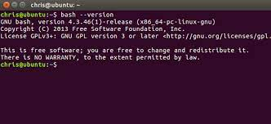
Bash Version
Default shell on Ubuntu is Bash (Bourne Again SHell)
$ bash --version

Slide 8
Shell Scripting
The shell script is a computer program designed to run by a shell
All the scripts have a .sh extension
To start a shell script file, use the hashbang (#!) construct
#!/bin/sh
Hashbang or shebang alerts the system that it is a shell script
Put the comment in your script using the # sign

Slide 9
Shell Scripting - Simple Example
$ nano new.sh
#!/bin/sh
# my first shell script
echo "What is your name?"
read NAME
echo "Hello, $NAME"

Slide 10
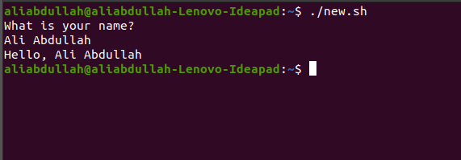
Shell Scripting - Output

Slide 11
Shell Scripting - Rules
Variables:
can only contain numbers (0-9), characters (a-z, A-Z), or underscore ( _ )
use "variablename=value" to set variable value
use $variable to read a variable's value
use "read variablename" to get the input from the user
use "readonly variablename" to make a variable readonly
use "unset variablename" to unset the value of a variable
Arrays:
array_name[index]=value //setting the array value on an index
{array_name[index]} //retreiving the array value on an index
{array_name[*]} or {array_name[@]} //access all values in the array

Slide 12
Shell Scripting - Variables
Local Variable
present in the current instance of the shell
not available to the programs started by the shell
set at the command prompt
Environment Variable
available to any child process of the shell
some programs need these to function correctly
only those are defined in the script that are required to run the program
Shell Variable
The special variable that is set by the shell
required by the shell to function correctly
some of them are environment variables, whereas others are local variables

Slide 13
Shell Scripting - Special Variables
Special Variables:
$0: filename of the current script
$n: correspond to the arguments with which the script was invoked
$#: Number of arguments supplied to a script
$*: All the arguments are double quoted
$@: All the arguements are individually double qouted
$?: the exit status of last command executed
$$: process number of the current shell, for shell scripts, this is the process ID under which they are executing
$!: The process number of last background command

Slide 14
Shell Scripting - Operators
Arithmatic Operations
+ (Addition)
- (Subtraction)
* (Multiplication)
/ (Division)
% (Modulus)
= (Assignment)
== (Equality)
!= (Not Equality)

Slide 15
Shell Scripting - Operators
Relational Operations
-eq: check if two operands are equal or not, if yes, the condition is true
-ne: check if two operands are equal or not, if not, the condition is true
-gt: check if value of left operand is greater than right operand, if yes, condition is true
-lt: check if value of left operand is less than right operand, if yes, condition is true
-ge: check if value of left operand is greater than or equal to the right operand, if yes, condition is true
-le: check if value of left operand is greater than or equal to right operand, if yes, condition is true

Slide 16
Shell Scripting - Operators
Boolean Operators
! => logical negation, inverts true to false and vice versa
-o => logical OR, if one operand is true, condition is true
-a => logical AND, if both operands are true, condition is true otherwise false

Slide 17
Shell Scripting - Operators
String Operators
= : check if two operands are equal or not, if yes, the condition is true
!= : check if two operands are equal or not, if not, the condition is true
-z : given operand size is zero, then true
-n : given operand size is non-zero, then true
str : check if non-empty string, if empty, returns false

Slide 18
Shell Scripting - Operators
File Test Operators
-b file: if block special file, then true
-c file: if character special file, then true
-d file: if file is directory, then true
-f file: if ordinary file, then true
-g file: if file has its set group ID (SGID) set, then true
-k file: if file has sticky bit set, then true
-p file: if file is a named pipe, then true
-t file: if file descriptor is open and associated with a terminal, then true

Slide 19
Shell Scripting - Operators
File Test Operators
-u file: if file has its set user ID (SUID) set, then true
-r file: if file is readable, then true
-w file: if file is writable, then true
-x file: if file is executable, then true
-s file: if file size is greater than 0, then true
-e file: if file exists, then true, even if it is a directory

Slide 20
Shell Scripting - Decision Making
if...else
if...fi
if...else...fi
if...elif...else...fi
if [ "variable" -ge "10" ] ; then
do something
elif [ "variable" -lt "10" ] ; then
do something
else
do something
fi

Slide 21
Shell Scripting - Decision Making
case...esac
case "$variable" in
value|value)
something
;;
value)
something
;;
*)
something
;;
esac

Slide 22
Shell Scripting - Loops
The while loop [while...do...done]
while condition;
do
Statements to execute if condition is true
done
The for loop
for variable in array[] or for (( ; ; ))
do
statements
done

Slide 23
Shell Scripting - Loops
The until loop
until condition
do
Statements to execute if the condition is true
done
The select loop
select variable in value1, value2, value3 ....
do
Statements to execute
done

Slide 24
Shell Scripting
break
terminate the execution of entire loop
continue
causes the current iteration of the loop to exit

Slide 25
Shell Scripting - Escape Sequence
\\ backslash
\a alert (BELL)
\b backspace
\c suppress trailing newline
\f form feed
\n new line
\r carriage return
\t horizontal tab
\v vertical tab

Slide 26
Shell Scripting - Command substitution
`command`
set the value of a variable as `commandtobeexecuted` to use commands in the code
DATE=`date`
echo "Date is $DATE"

Slide 27
Shell Scripting - Output Redirection
echo "string"> file1.txt
Overwrites output to the file instead of writing it on the standard output
echo "string">> file1.txt
Appends output to the file instead of writing it on the standard output

Slide 28
Shell Scripting - Functions
break down the functionality of a script into smaller logical subsections, that can be called upon to perfom tasks when needed
function_name() {
list of commands
}

Slide 29
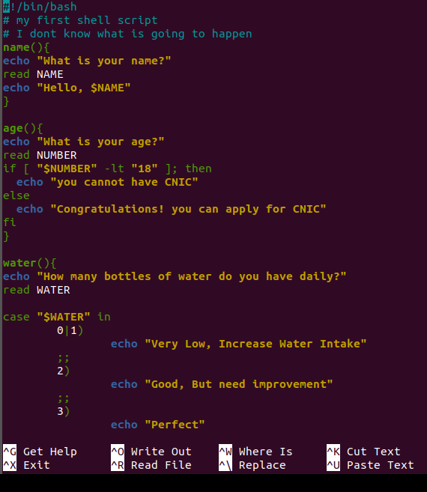
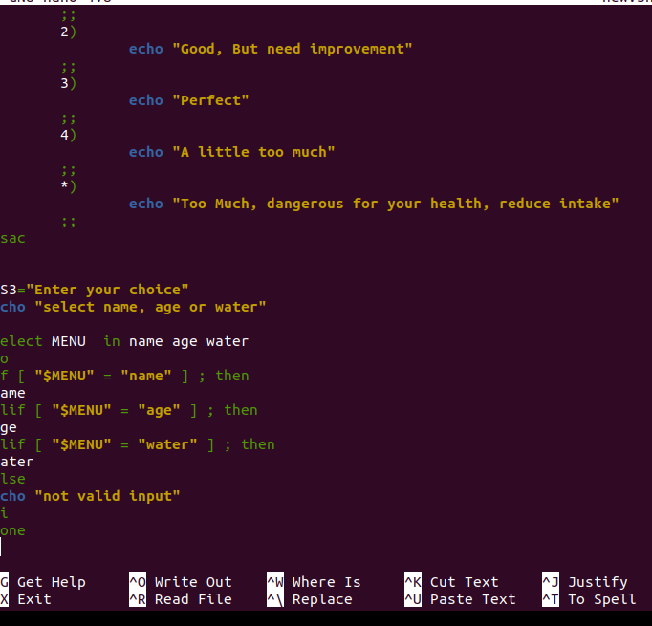
Shell Scripting - Example

Slide 30
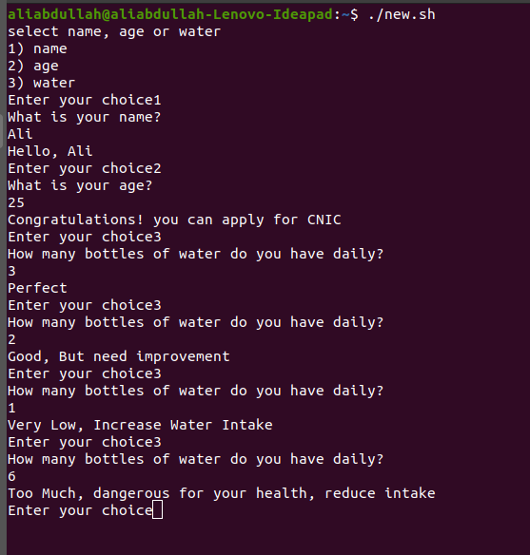
Shell Scripting - Output

Slide 31
Environment Variables
Variables with values set outside the program, typically through a functionality built into the operating system

Slide 32
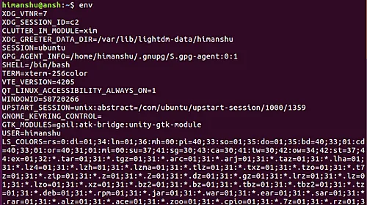
env
command to print the list of environment variables or run a utility in an altered environment without having to modify existing environment

Slide 33
Sed
stream editor: for filtering and transforming text
Syntax: sed OPTIONS... [SCRIPT] [INPUTFILE...]
Replace or Substitute String
$ sed 's/old/new/' file.txt
's' is substitution operation
"/" are delimiters, by default replace only the first occurrence in each line
use /1, /2 flags for the number of occurrences in each line to replace
use /g (global) to replace all the occurrences
use /ng, where n is the number of occurrences onwards, e.g /3g will replace 3rd occurrence onwards in each line.

Slide 34
Sed
Replacing string on a specific line number (replace on 3rd line)
$ sed '3 s/new/old/' file.txt
Replacing string on a range of lines
$ sed '1,3 s/new/old/' file.txt
$ sed '1,$ s/new/old/' file.txt
Duplicate the replaced line
$ sed 's/new/old/p' file.txt
Print only replaced lines
$ sed -n 's/new/old/p' file.txt

Slide 35
Sed
Delete lines from file (replace the line number with n)
$ sed 'nd' file.txt //line number n will be deleted
$ sed '$d' file.txt //last line number will be deleted
$ sed 'x,yd' file.txt //lines x to y will be deleted
$ sed 'n,$d' file.txt //lines n to last will be deleted
Delete Matching pattern line
$ sed '/pattern/d' file.txt
Insert blank line after each line
$ sed G file.txt

Slide 36
Sed
Delete Blank lines and insert one after each line
$ sed '/^$/d;G' file.txt
Numbering Lines
$ sed = file.txt | sed 'N;s/\n/\t/'

Slide 37
Awk
Aho, Weinberger, Kerninghan (Authors)
Scan each input file for lines that match any of a set of patterns specified
Syntax: awk '/regex pattern/{action}' your_file_name.txt
Awk Operations:
Scan a file line by line
Split input line into fields
compare input line/fields to pattern
Perform actions on matched lines

Slide 38
Awk
Useful for
Transform data files
Produce formatted reports
Programming Constructs:
Format output lines
Arithmetic and string operations
Conditionals and loops

Slide 39
Awk
Aho, Weinberger, Kerninghan (Authors)
Scan each input file for lines that match any of a set of patterns specified
Syntax: awk '/regex pattern/{action}' your_file_name.txt
The default behavior of awk
$ awk '{print}' file.txt //prints every line from specified file

Slide 40
Awk
Print line matching the pattern
$ awk '/manager/ {print}' file.txt
Split line into fields
$ awk '{print $1,$4}' file.txt
by default the values are divided on whitespaces. $n will print the n number word in the lines. $0 will be used to print entire line

Slide 41
Awk
Print Line number
$ awk '{print NR,$0}' file.txt
Print specific line number (3 to 6)
$ awk 'NR==3, NR==6 {print NR,$0}' file.txt
List all users in Linux
$ awk -F ':' '{ print $1}' /etc/passwd
-F: field separator
/etc/passwd: file containing information about users
$1: first value separated with the field separator ':'

Slide 42
Awk
NR: Number of input records
NF: Number of fields in the current record
FS: Field Separator (default: White Space)
RS: Record Separator (default: Input Line)
OFS: Output Field Separator (default: blank space)
ORS: Output Record Separator (default: newline character)

Slide 43

User management
Creating User Accounts
Deleting User Accounts
Enabling User Accounts
Disabling User Accounts
Assigning Groups to Users
Assigning Shells to Users
Managing Passwords
managing passwords

Slide 44
User management
Add New User
adduser
Add user to the system according to CLI options and configuration information in /etc/adduser.conf
friendlier than useradd
set home_dir, group, uid, gid, shell for new user
useradd
Low level utility for adding users
low level means closest to raw data, to the kernel interface etc.
Syntax: $ sudo adduser [options] user
$ sudo useradd [options] user

Slide 45
User management
Add New Group
addgroup
Add group to the system according to CLI options and configuration information in /etc/adduser.conf
friendlier than groupadd
groupadd
Low level utility for adding groups
Syntax: $ sudo addgroup [options] [--gid ID] group
$ sudo groupadd [options] group

Slide 46
User management
Delete User
deluser
removes user from the system according to CLI options and configuration information in /etc/deluser.conf
userdel
Low level utility for deleting users
Syntax: $ sudo deluser [options] user
$ sudo userdel [options] user

Slide 47
User management
Delete Group
delgroup
removes group from the system according to CLI options and configuration information in /etc/deluser.conf
groupdel
Low level utility for deleting groups
Syntax: $ sudo delgroup [options] [--only-if-empty] group
$ sudo groupdel [options] group

Slide 48
User management
Modify User
usermod
modify a user account such as username, password, home directory, default shell etc
Syntax: $ sudo usermod [options] user

Slide 49
User management
Add user to a group
$ sudo usermod -a -G groupname username
Change user's primary group
$ sudo usermod -g groupname username
Remove user from a group
$ sudo gpasswd -d username groupname

Slide 50
User management
chsh - change login shell for a user
$ sudo chsh [options] [LOGIN}
Available shells can be seen in /etc/shells file
Change user's primary group
$ sudo usermod -g groupname username
see the groups in which the user belong using groups command
Remove user from a group
$ sudo gpasswd -d username groupname

Slide 51
User management
passwd command
Force Users to change passwords next time they login
Lock a user's password (prevent it from being used)
Set minimum number of days before changing password
Specify user when to change password
Set max number of days to use password without changing
Syntax: $ passwd [options] [LOGIN]

Slide 52
User management
Disable User
$ sudo passwd -l user //lock
Enable User
$ sudo passwd -u user //unlock
Force to change password on next login
$ sudo passwd -e user //expire
Max number of days a password remain valid
$ sudo passwd -x max_days user
number of days to show a warning to change password
$ sudo passwd -w warn_days user

Slide 53
Switch User
su username
su [options] [-] [user [arguments...]]
Can be used as a substitute user to run commands or switch user.

Slide 54
Learning Objectives
Module 2 - Lecture 5
Bourne-Again Shell (bash)
Linux Kernel
User Management
System Administration

Slide 55
Next Lecture
Module 2 - Lecture 6
Linux Permissions
Disk Partition / Logical Volume Management
Run levels / init / systemd

Slide 56

Ask Questions!!

